Slide 1

YTP Arduino – Lesson 2
May 2018

Slide 2
Goals
To understand the question “what a micro-controller?”
Learn how to setup an Arduino
Understand Analogue and Digital
Learn how to create the most basic Arduino project
Success Criteria
Setup an Arduino successfully
Complete the Arduino Blink project

Slide 3
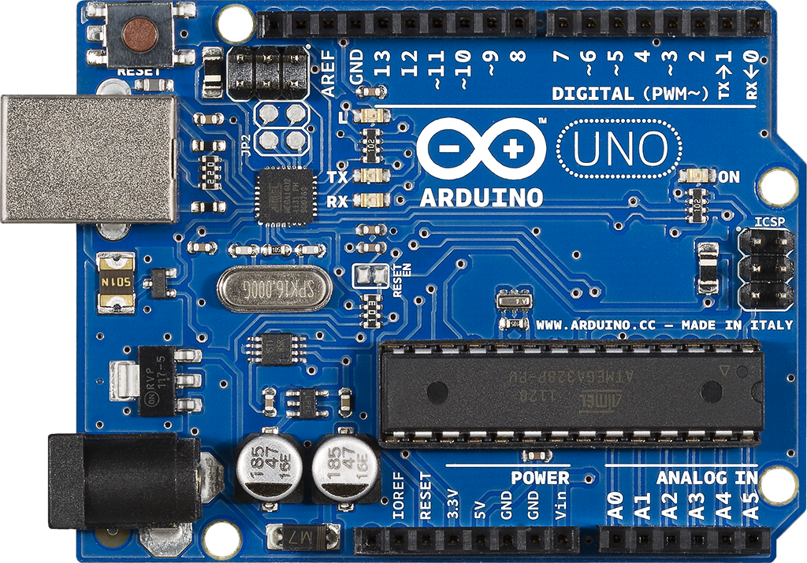

Slide 4

Analogue vs Digital

Slide 5
Arduino PINS
PINS
INPUT
OUTPUT

Slide 6
Making ‘sense’ of the World

Slide 7
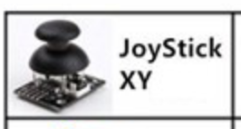
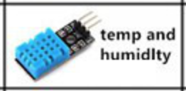
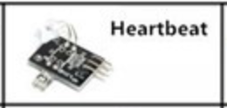
Arduino PINS
INPUT
OUTPUT
PINS
40C

Slide 8
Arduino PINS
INPUT
OUTPUT
40C

Slide 9
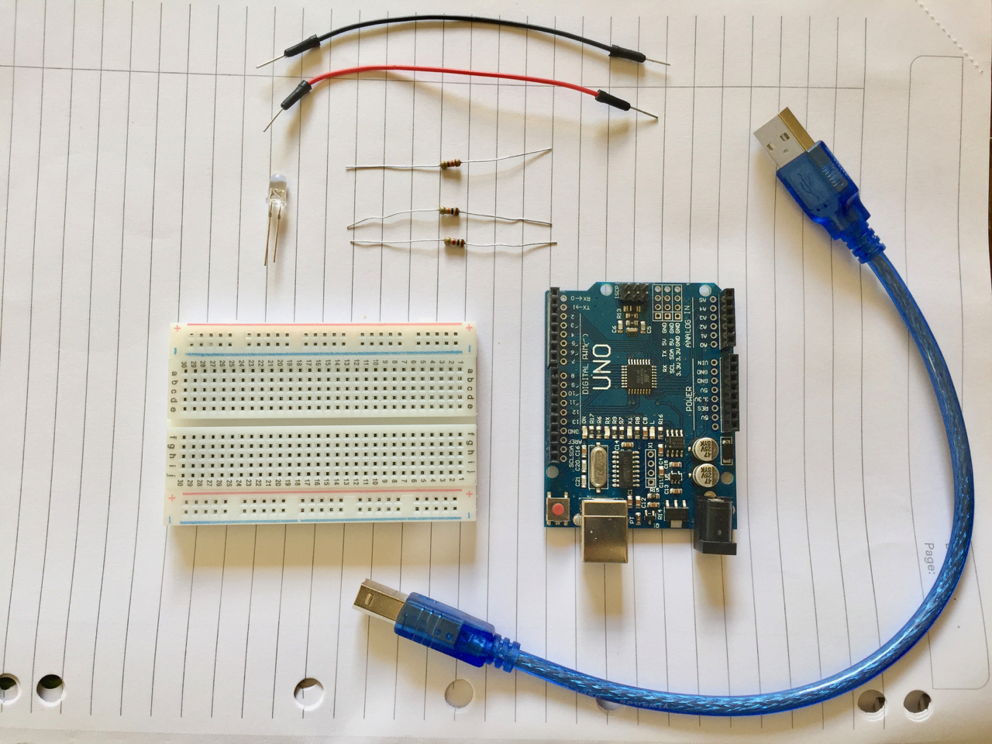
Blink – What you need
2 jumper wires
1 LED
1 220Ω resistor
1 Breadboard
1 Arduino UNO
1 USB cable

Slide 10
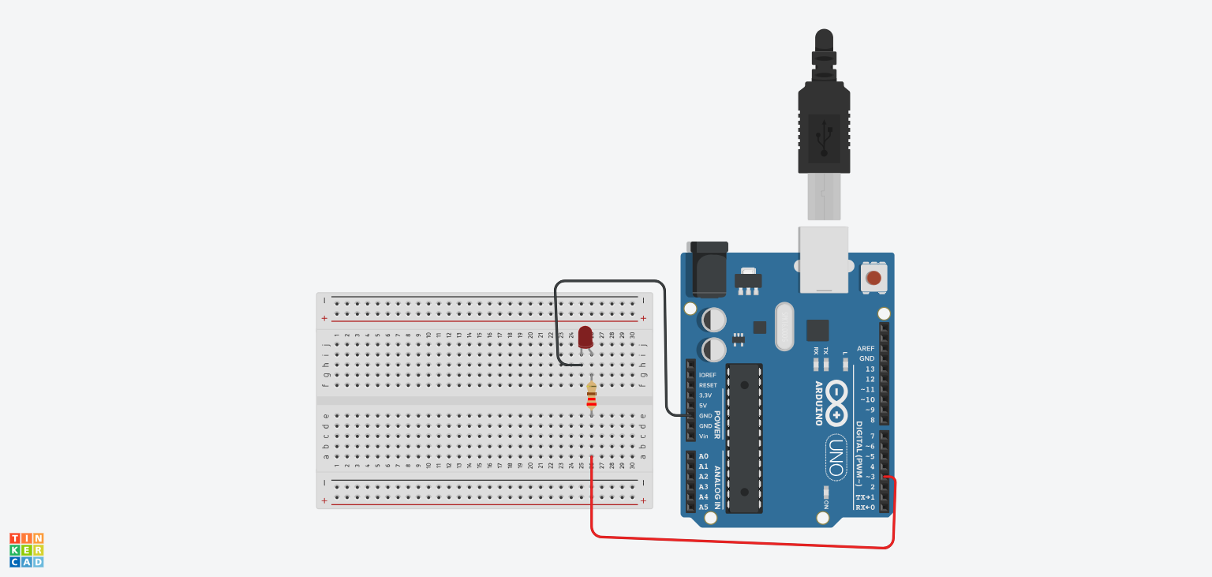
Blink – Building the Circuit

Slide 11
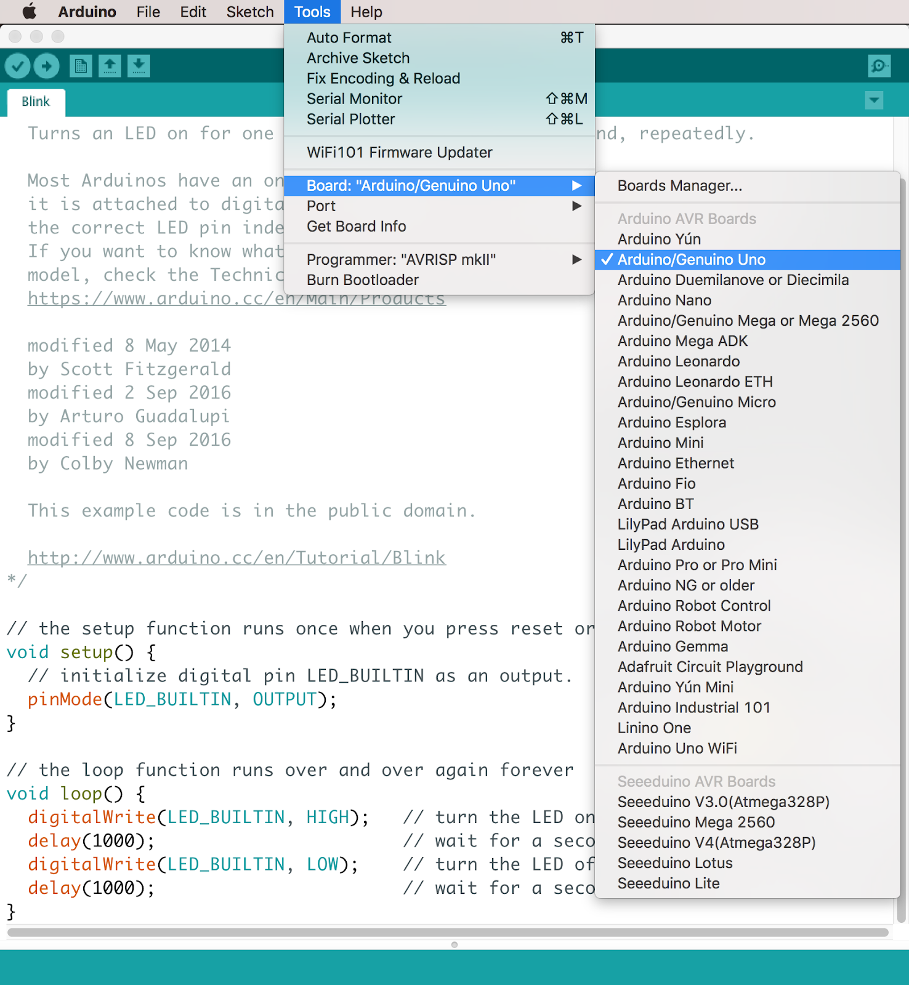
Blink – Coding the Circuit
Open the Arduino application
Open Blink: File > Examples > 01.Basics > Blink
Plugin your USB cable
Select Arduino UNO in Tools -> Board
Select the port in Tools -> Port
Verify your code
Upload your code

Slide 12

Extension Activity
1. Swap the resistor for a higher value one
2. Add another blinking LED
What components do you need?
Do you need to use another PIN on the Arduino?
Do you need to write more code?
1000Ω
Does anything different happen? Why?

Slide 13
Homework
Recap of Arduino hardware and software:
bit.ly/ytp01-led-blink
Using the Arduino Editor
bit.ly/ytp01-the-arduino-editor

Slide 14


